Slide 1
SRT Data Process
Improving Data Quality and Quantity for Machine Learning
Bri McGowan & Arthur Brunson | 04/19/2022

Slide 2

Machine Learning
“Machine Learning” is a branch of artificial intelligence (AI) and computer science which focuses on the use of data and algorithms to imitate the way that humans learn, gradually improving its accuracy.
IBM

Slide 3
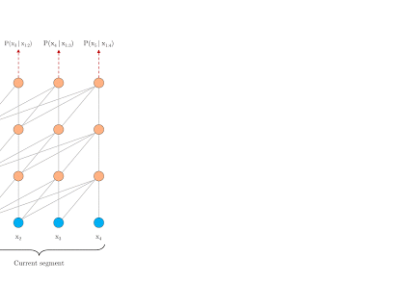
NLP
Natural Language Processing (NLP) strives to build machines that understand and respond to text or voice data—and respond with text or speech of their own—in much the same way humans do.
IBM
IBM Watson Interactive Demo

Slide 4



Current SRT NLP Model
Machine learning
Non-compliant
Compliant
Tagged Docs
Feature Selection
Machine Learning
Text Classifier
Natural Language Processing
Untagged Docs

Slide 5
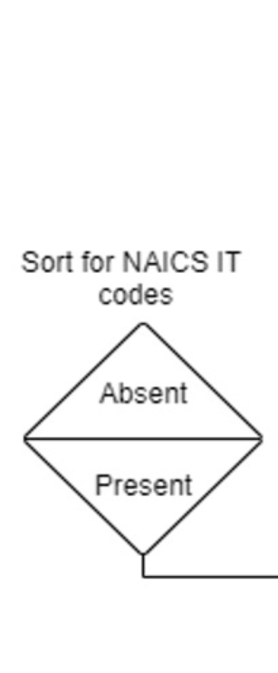
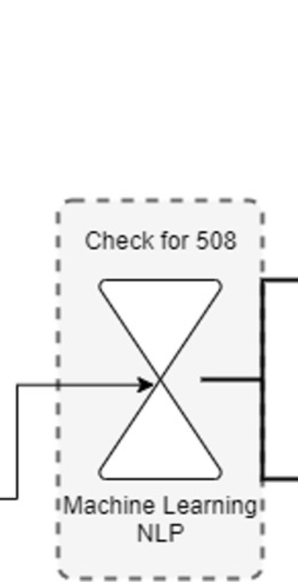
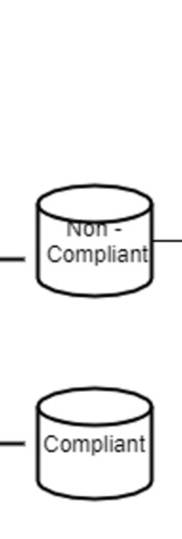
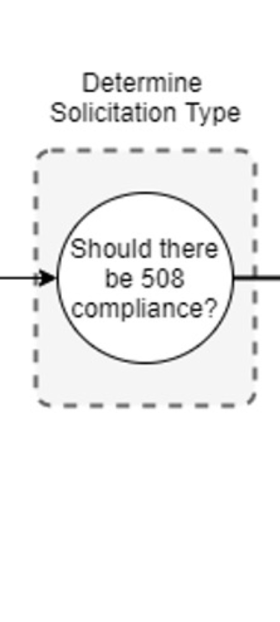
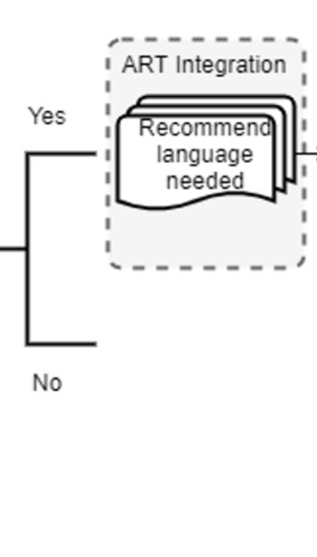
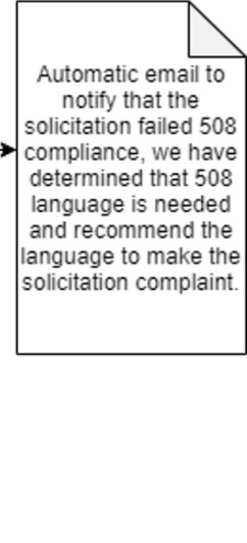
Solicitations Review Tool (SRT)
Life Cycle
Notes:
ART can be integrated into the SRT to provide recommendations for the language needed to make a solicitation 508 compliant.

Slide 6
Desired Goals
Improving and Increasing the Data
Current | Future
993 labelled Solicitations | 5,000 labelled solicitations
20% margin of error of false labels | 5% margin of error of false labels
90% accuracy rate for NLP | 95%< accuracy rate for NLP
Notes:
With limited data, we run the risk of faulty tagging. With NB, SVM, and CNN running at once, we can choose which algorithm has the highest accuracy and use the output from that algorithm. It allows more flexibility in the type of solicitation docs the machine learning algorithms can classify text with.
Feature Extraction: Convert the text files into numerical feature vectors by segmenting each text file into words (for English splitting by space), and counting # of times each word occurs in each document and finally assigning each word an integer id. Each unique word in our dictionary will correspond to a feature (descriptive feature). Scikit-learn has a high level component which will create feature vectors for us ‘CountVectorizer’.
Use different ML models & choose the classification from the model with the highest accuracy.

Slide 7
Standardize Labelling Process for SRT
The Solicitations Requirements Tool (SRT) is a machine learning model that looks at solicitations with specific NAICs codes (see Appendix A) and generates whether a solicitation has 508 compliance language or not. To train and improve our SRT machine learning model, more data is required. This is a guidance template designed to decentralize the solicitation labeling process.
Work with agencies to come up with a way to standardize identifying exemptions.
GREEN | RED
References to ‘Section 508’ or ‘Rehabilitation Act of 1973’ are present | Neither the key terms or standards or clauses are present in the document
Standards are present | Exemptions are not specified
Clauses are present
Exemptions are specified
Table for labeling Solicitation Data
Guidance Document Here
Notes:
When exemptions apply, there currently is not an identifier that says a solicitations should be exempt.
Each agency will receive sample solicitations and a spreadsheet to label solicitations as GREEN, RED, or UNSURE. Once labeling is complete, the agency will send the spreadsheet back to the Section 508 team’s point of contact.
Note: We are only labeling solicitations we know should have 508 compliance language included based on the NAICs codes (See Appendix A).
Note: If the person is unable to determine GREEN or RED, we may invite SMEs from the Section 508 team to make a determination.

